Slide 1
Universidad del Valle Facultad de Humanidades Escuela de Ciencias del Lenguaje Licenciatura en Lenguas Extranjeras Habilidades Integradas en Inglés 3 Junio 15 de 2014 Professor: Andrés Valencia Student: Harold Rodriguez Echeverry I.D 0328156

Slide 2
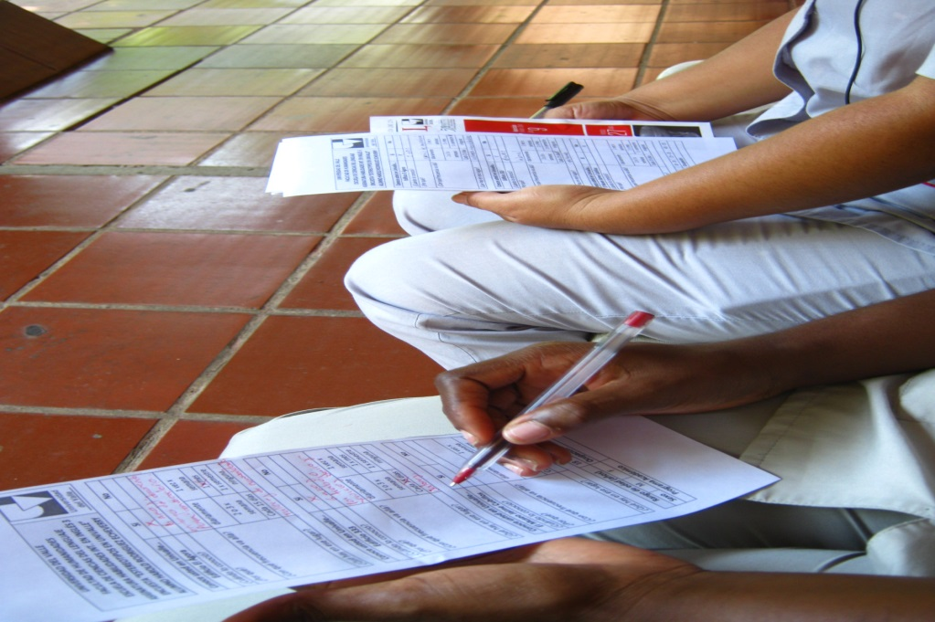
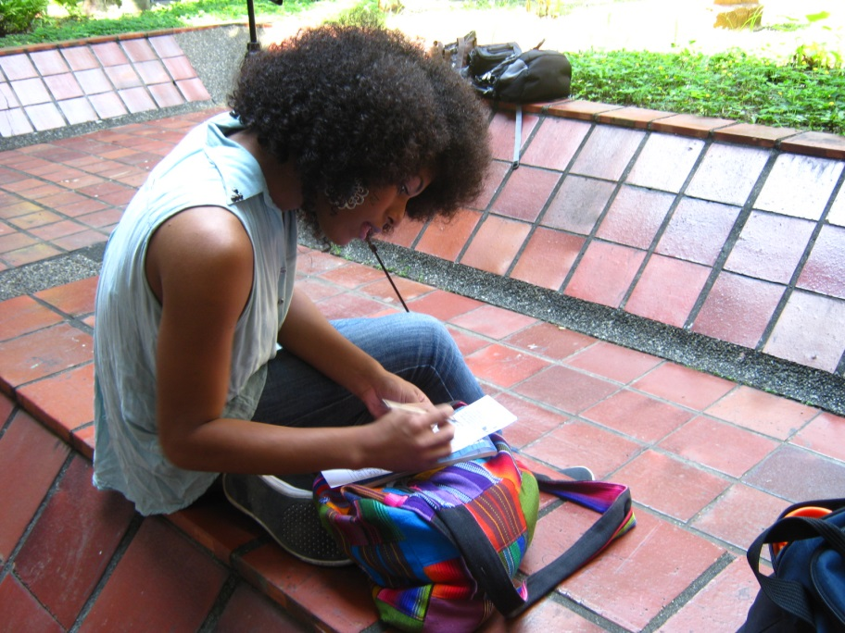
Final Project: “Stereotypes in Univalle ” Survey made up in Univalle about: El Ágora 305 Building 333 Álvaro Escobar Navia Building Julio César Cubillos Museum

Slide 3
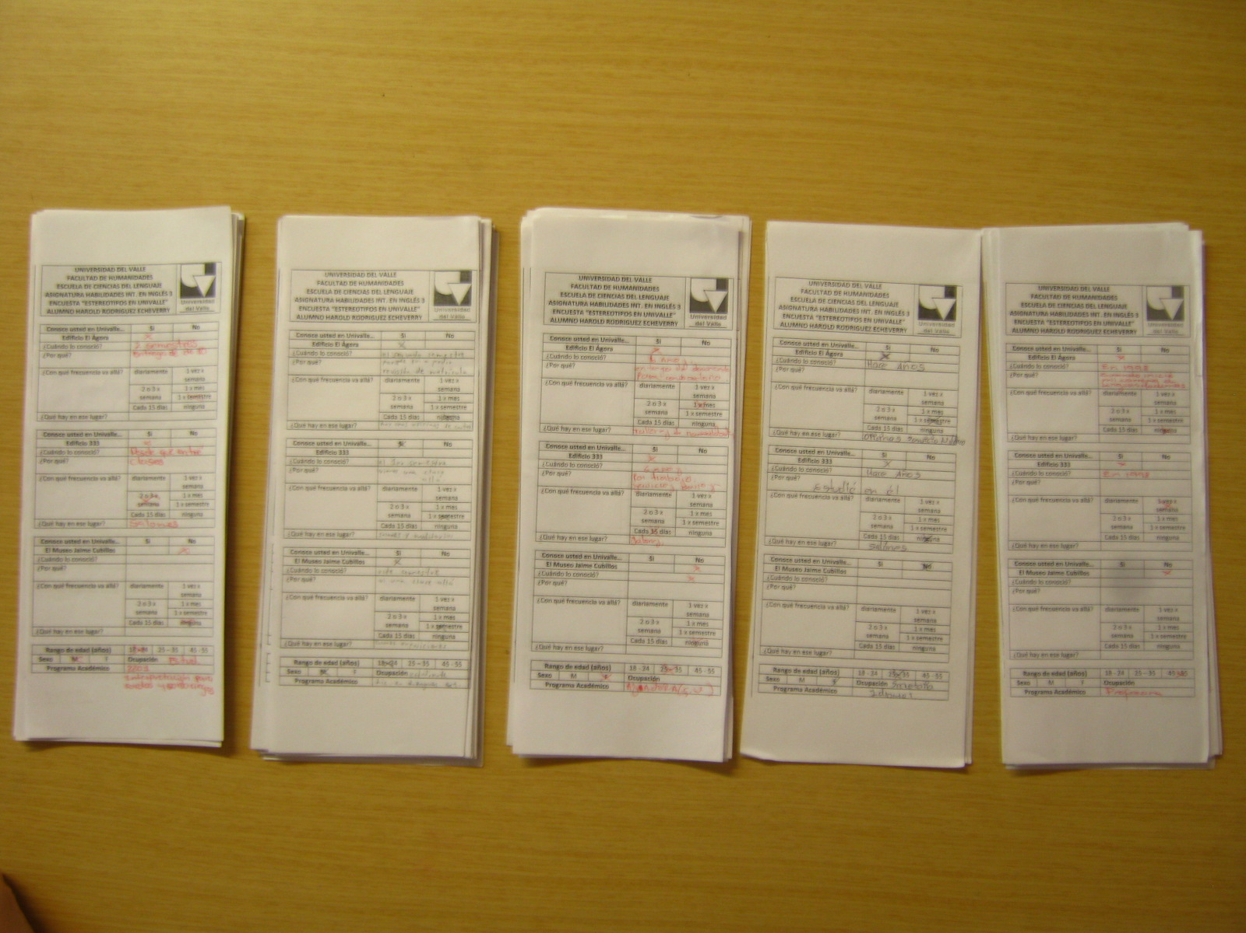
THE SURVEY

Slide 4
GENDER OF THE SURVEY TOTAL: 60 PEOPLE MEN 19 WOMEN 41

Slide 8
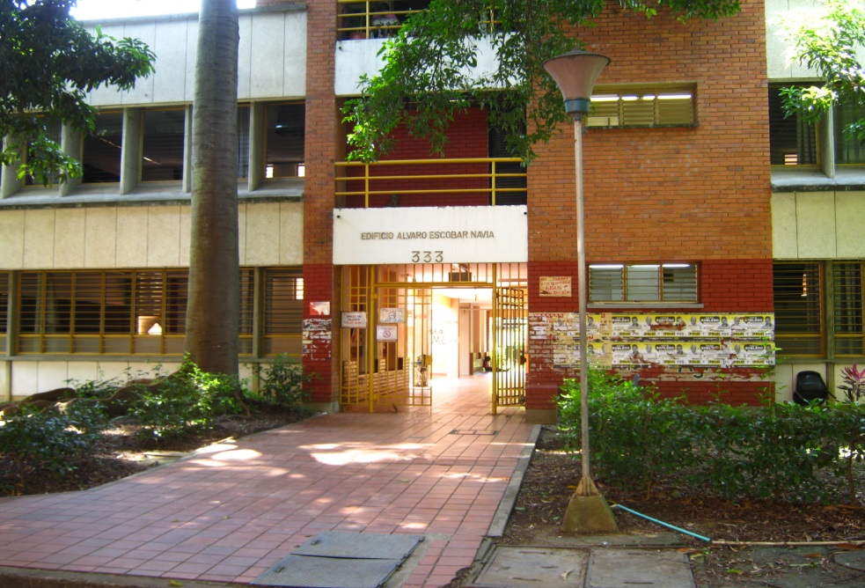
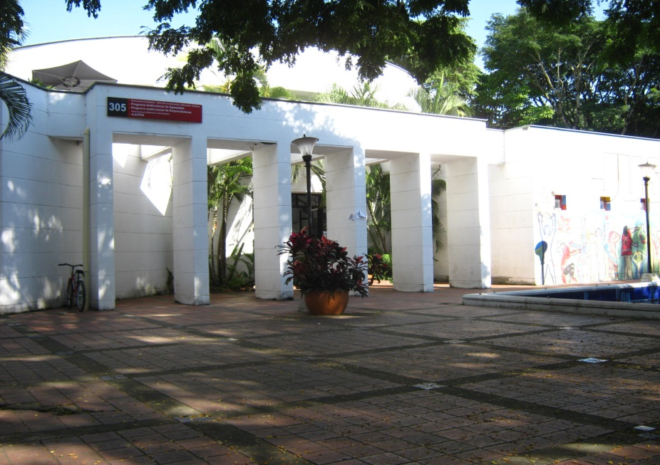
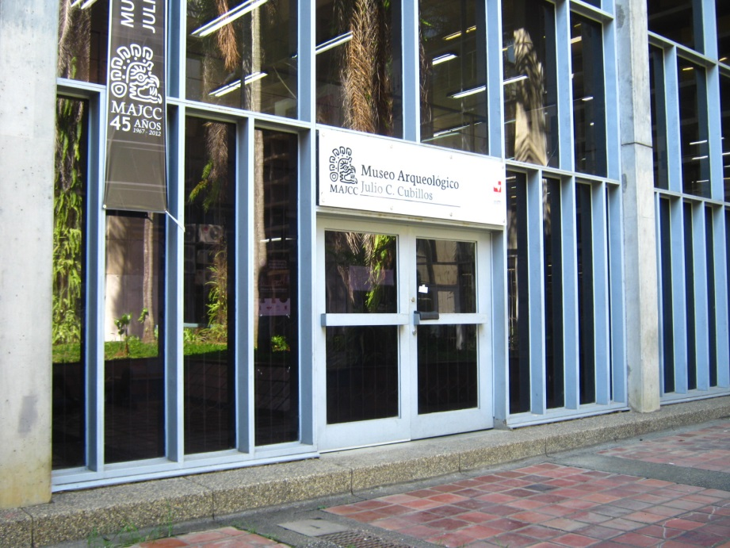
Do you know In Univalle…?

Slide 22
Curiosities facts
* One person visits daily El Ágora Building, the 333 Álvaro Escobar Navia Building and the Julio César Cubillos Museum. Is the professor William in charge of the Museum.
*One professor of Escuela de Ciencias del lenguaje still doesn´t know the El Ágora Building.
* One student visits daily the 333 Álvaro Escobar Navia Building because she works thare as a monitor.
* One professor visits daily the El Ágora Building because she teaches in oil painting classes. She doesn´t know the 333 Álvaro Escobar Navia Building and the Julio César Cubillos Museum in Univalle.
* One student visits daily the Julio César Cubillos Museum because she works there as a monitor student.
* One student doesn´t know the Building El Ágora and the Julio César Cubillos Museum yet. She is Marion Dpuvoi… a foreign student and she worked as a professor in French area in Escuela de Ciencias del lenguaje.
* One student visits daily El Ágora Building because she works there as a monitor.
One janitor only knows the Julio César Cubillos Museum in Univalle.

Slide 23
Curiosities Answers of the Survey: How many times did you know it…? El Ágora: Since it was the foundation. 333 Building: I know it twenty four years ago when I stared to work here. Julio C. Cubillos Museum: Since I was gathering some archeological pieces. Why did you go there? El Ágora: It´s impossible not to see it , it’s seen from the street. 333 Building: It was the intelligent building at that time. Julio C. Cubillos Museum: Because I live here. What´s in there? El Ágora: There is a waiting room. 333 Building: There are Primiparos Julio C. Cubillos Museum: The history of Colombia.

Slide 24
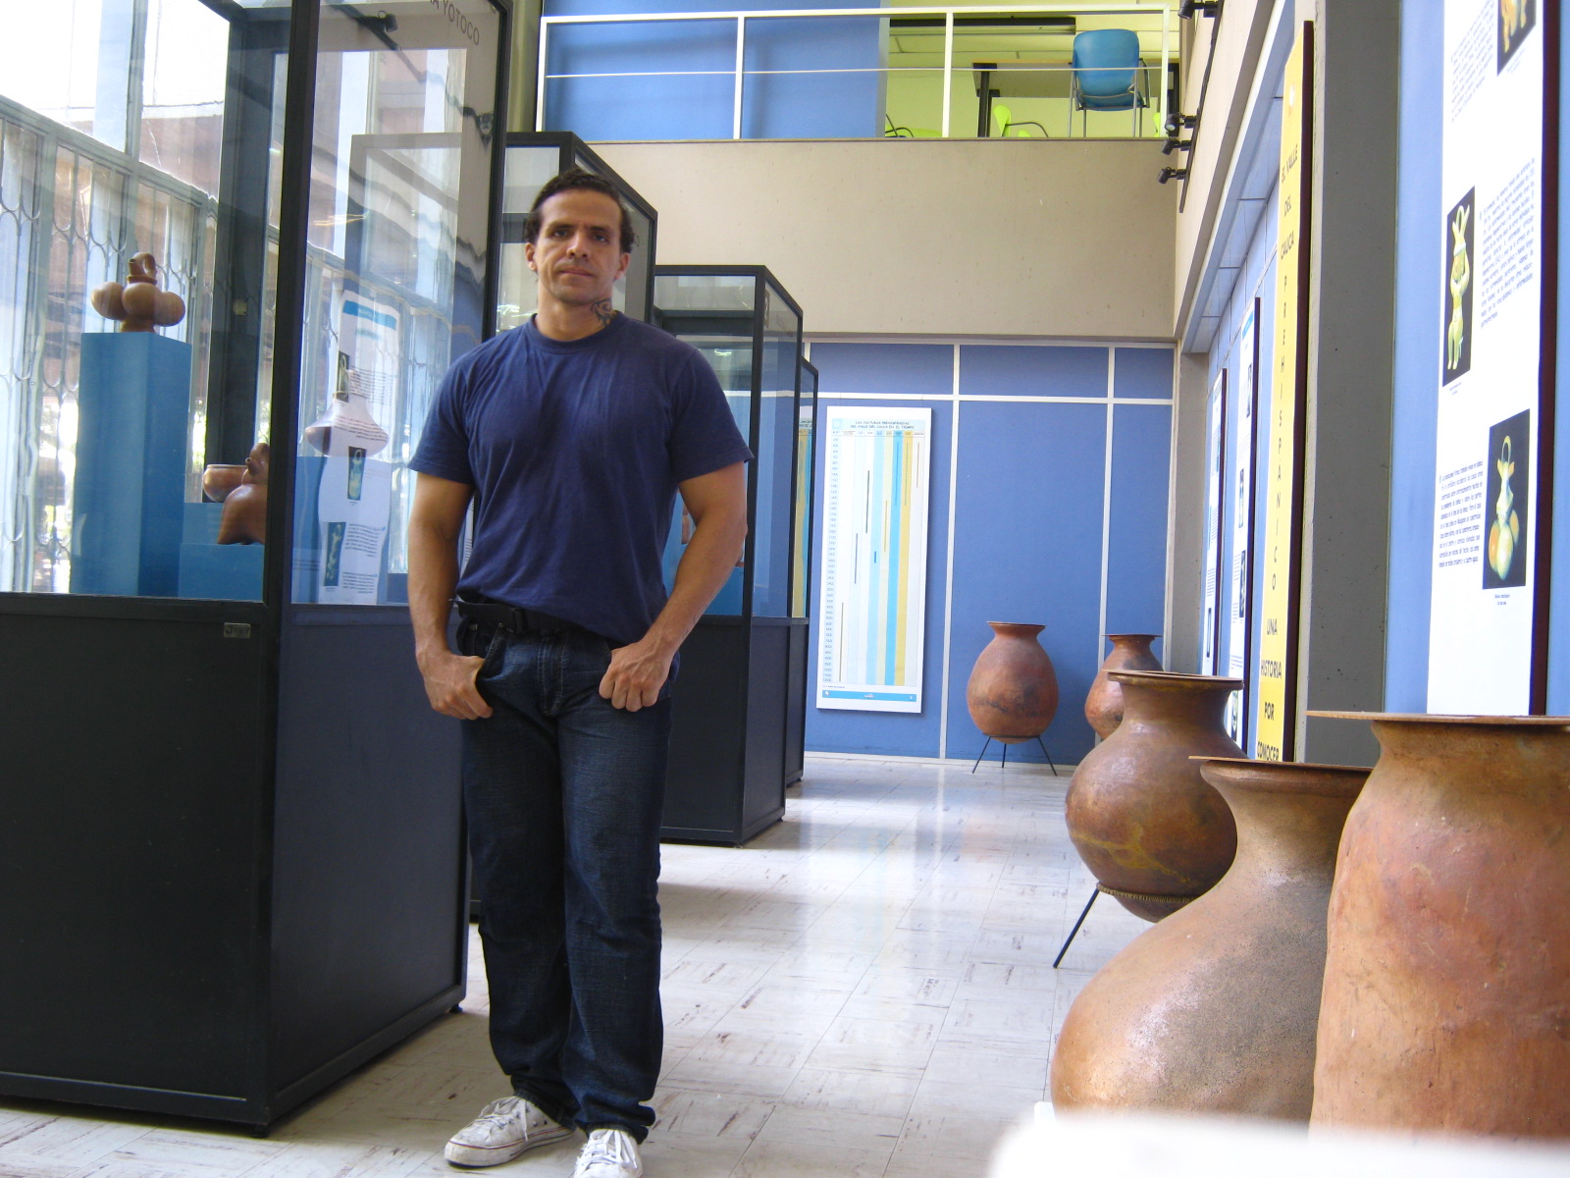
Thanks!

